Slide 1
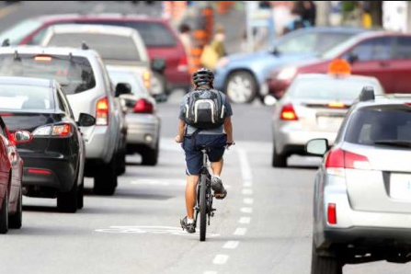

CycleSafe: Safe Route Planning for Urban Cyclists
Project 67
Sahil Chauhan
Mehdi Shah
Supervised by Xuyun Zhang

Slide 2

Introduction
62%^{[1]} increase in popularity of cycling
Increasing due to ridesharing services such as ONZO
E-Bikes
Increase in traffic congestion^{[2]}
Due to increasing population
Notes:
According AT, increase popularity of cycling.
Ridesharing, E-bikes
Increase in traffic congestion
Increasing population

Slide 3
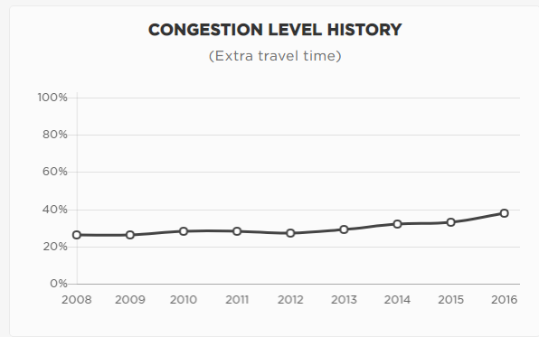

Slide 4
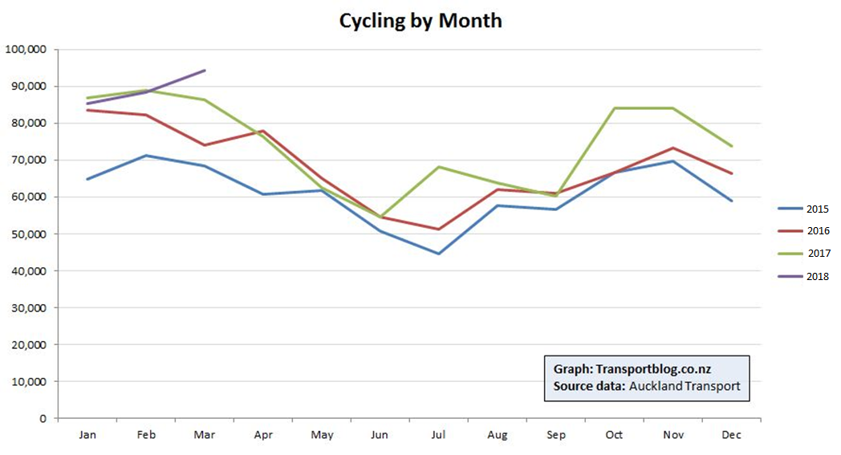

Slide 5
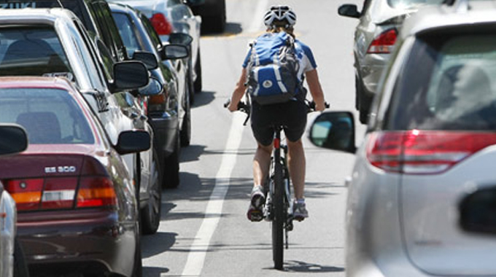
The Problem
Lack of cycling infrastructure
Cyclists share the road with motorists
Cyclists have little protection
Decreased stability
Direct contact with environment
Notes:
Lack of cycling infrastructure – as cycling popularity increases, dedicated infrastructure takes time and money to build.
Cyclists forced to share the road with motorists.
Cyclists lack visibility, have very little protection and are in direct contact with the environment.

Slide 6
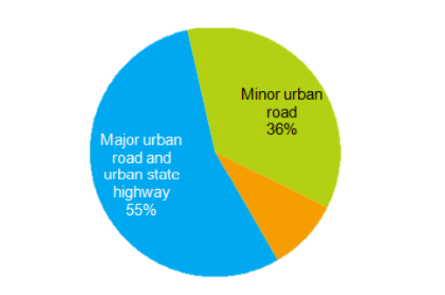
The Problem
Number of cyclist injuries/death significantly high at ~700/year^{[4]} from police reported crashes.
Many go unreported
Incidents happen on both major and minor roads^{[5]} .
Open road
9%
Notes:
Approximately 700 police reported incidents per year resulting in injury or death.
Incidents happen on all types of roads, due to collision with motorists.

Slide 7

The Problem
Not enough work is done to ensure safety
Cyclists do not have any ways to plan a safe trip
Safety Factors
Traffic
Weather
Notes:
Apart from awareness campaigns, we believe not enough work is being done regarding the safety of cyclists.
We have decided to help remedy this issue by focusing on route planning for cyclists. The safety factors we are looking into are traffic conditions and weather conditions.

Slide 8


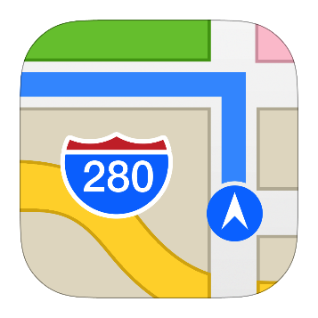

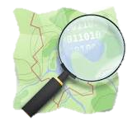

Related Work
Google Maps
Shortest Path
Flattest Route
Open Cycle Map
Cycle path map
No route planning
Komoot
Cycling paths based on fitness
Doesn’t use congestion
Notes:
There are some cycling related tools currently on the market.
The most notable one being Google Maps. For cyclists, Google Maps finds the shortest possible path to a destination. It doesn’t take into account traffic congestion.
Flattest route is a service which gives you a path with the least change in elevation.
Open cycle map is a service which displays dedicated cycle ways – doesn’t plan route.
Komoot is a route planning tool to find routes for cyclist based on fitness ability.

Slide 9
Shortcomings of Existing Work
Applications | Shortest Path | Cycleway support | Elevation Tracking | Traffic Congestion | Weather
Google Maps | ✔ | ✔ | ✔ | ✖ | ✖
Flattest Route | ✖ | ✖ | ✔ | ✖ | ✖
Open Cycle | ✖ | ✔ | ✖ | ✖ | ✖
Komoot | ✔ | ✔ | ✔ | ✖ | ✖
Proposed | ✔ | ✔ | ✔ | ✔ | ✔
Notes:
As you can see, the above applications each have their own benefits, however all lack a safety feature.
While the apps take into account shortest path and elevation, we feel like that can be risky at peak hours and it is advisable to take alternative routes to lower the risk.
Our proposed solution will take into account traffic congestion and weather conditions.

Slide 10

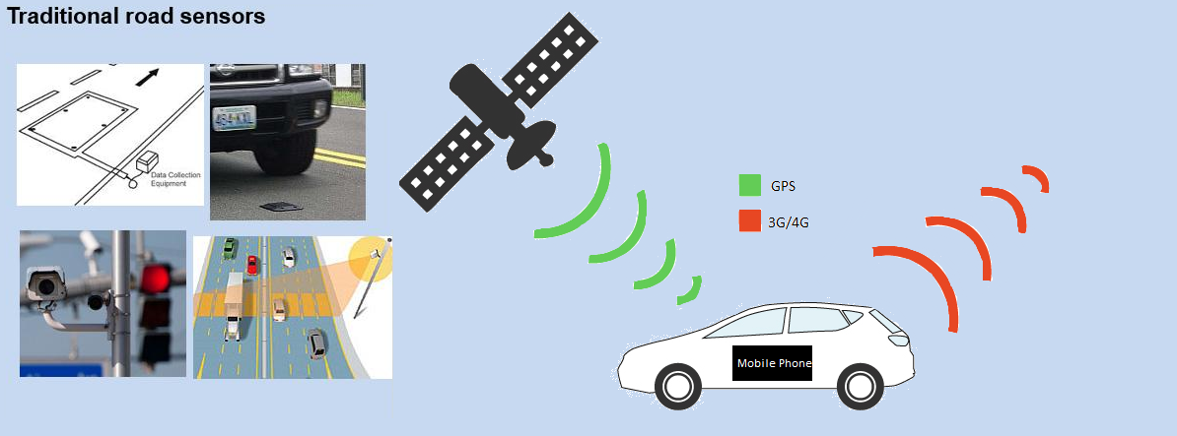
Existing Data Collection Techniques
Traditional methods
Underground/Radar sensors
Roadside cameras
-> Expensive, lack redundancy
Floating Car Data (FCD)
Collected from mobile phones
Google, Bing, Here Maps
-> Good for real-time data
Notes:
In order to take into account traffic congestion data, we must find a reliable source.
Traditional methods such as inductive loop sensors, radar sensors and roadside cameras are static methods as they are fixed. These methods are expensive to implement, hard to maintain and lack redundancy.
There is also a significant delay with capturing the data and then storing it.
The next option is floating car data – which is collected from GPS units placed inside vehicles.
Using GPS we can get the vehicle location and speed, process that data and then store it in the cloud so it’s ready for use.

Slide 11
Floating Car Data
Accurate data source
Real time
Easily obtainable
Google, Bing provides this data.
No taxi data set for Auckland
Notes:
Because of the nature of our problem, we require accurate, real-time data.
This is why we have decided to use floating car data as our main method of data collection.
We can source this data from Google, Bing and other companies – we have chosen this because we cannot source any GPS taxi data for Auckland.

Slide 12
Safe Traffic Conditions
Traffic Condition | Safety
No traffic | High
Very high congestion (Standstill) | Medium
High congestion (Slow-moving) | Low
Low congestion | Medium
Dedicated cycle lanes take priority as High safety
Notes:
Now that we have congestion data, we must still define what is SAFE for a cyclist.
Looking at the above table, we can see that no traffic is the highest level of safety.
Once we have congestion, we classify it into moving/non-moving. If the traffic is standstill/very high congestion, we give it a medium safety score. This is because while there is close proximity between cars and cyclists, cars are practically stopped.
Comparing this with slow moving traffic – cyclists and cars are both moving. This is higher risk which is why we classify it as Low safety.
Low congestion – medium safety.
Lastly, dedicated cycleways take priority as the highest level of safety.
Using these conditions, we can now plan a safe route for cyclists.

Slide 13

Weather
Weather used to provide warnings in case of poor weather conditions
Rain
Headwinds
Plentiful real-time and prediction services available
Wunderground provides these services

Slide 14
Our Solution & Evaluation
Presented by Mehdi
Notes:
Mention route is traffic and short path only weather is just warnings

Slide 15
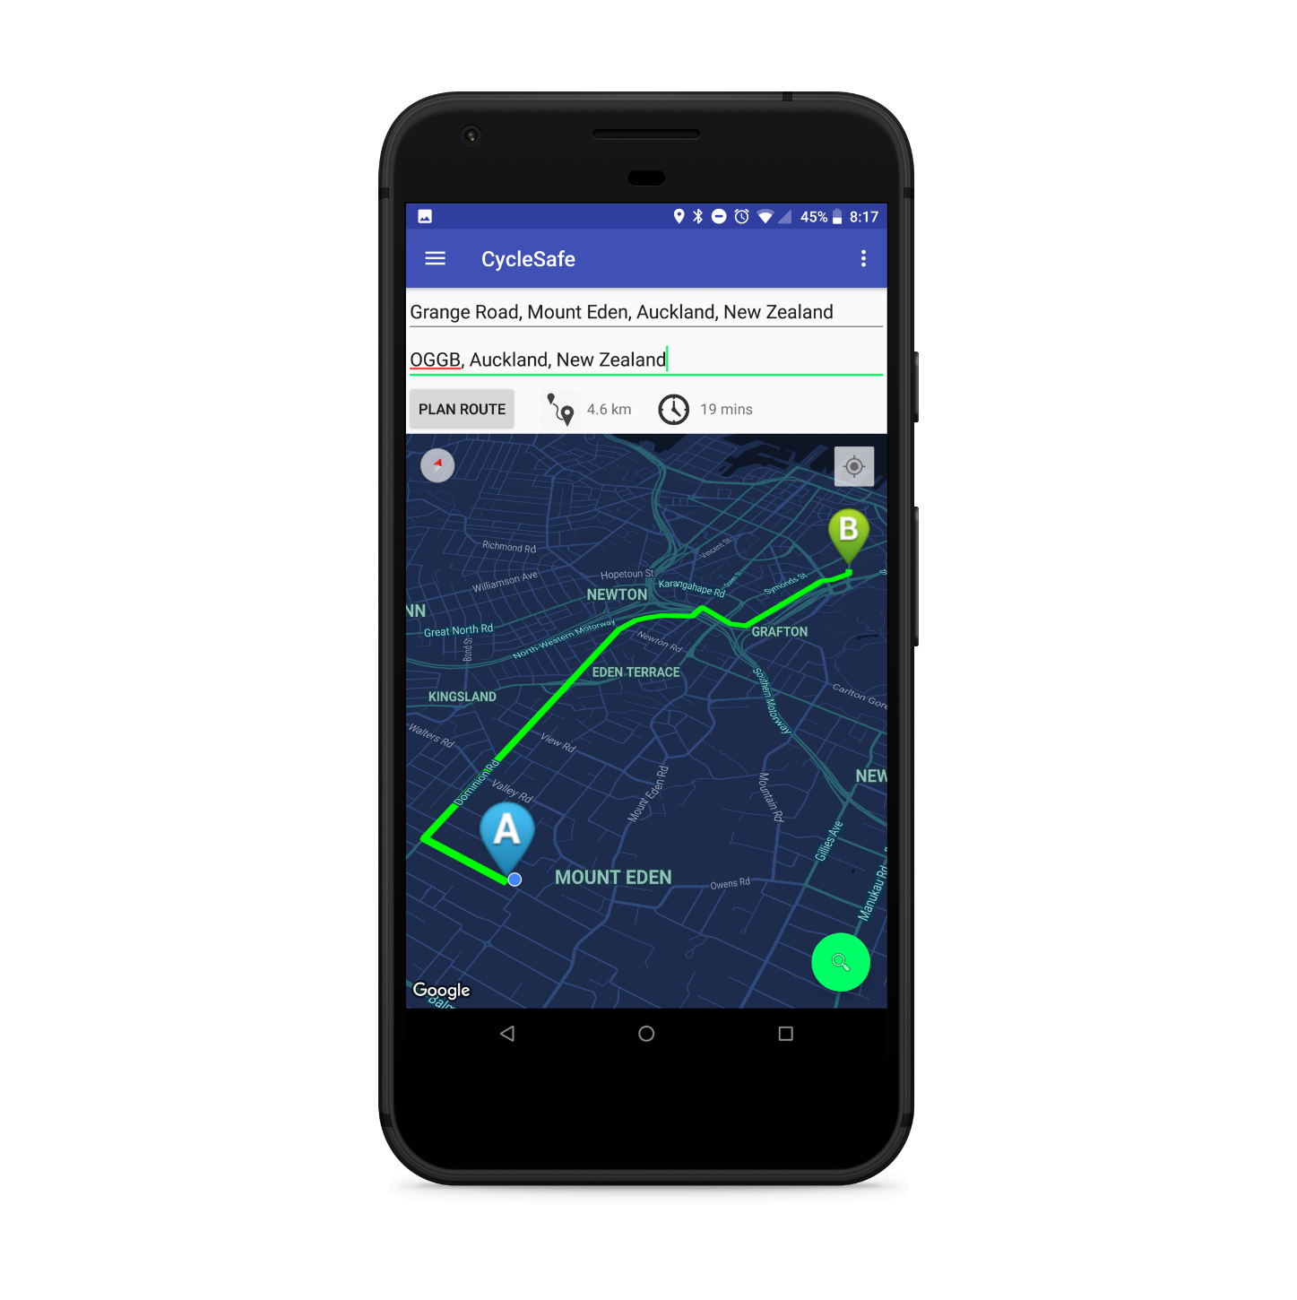
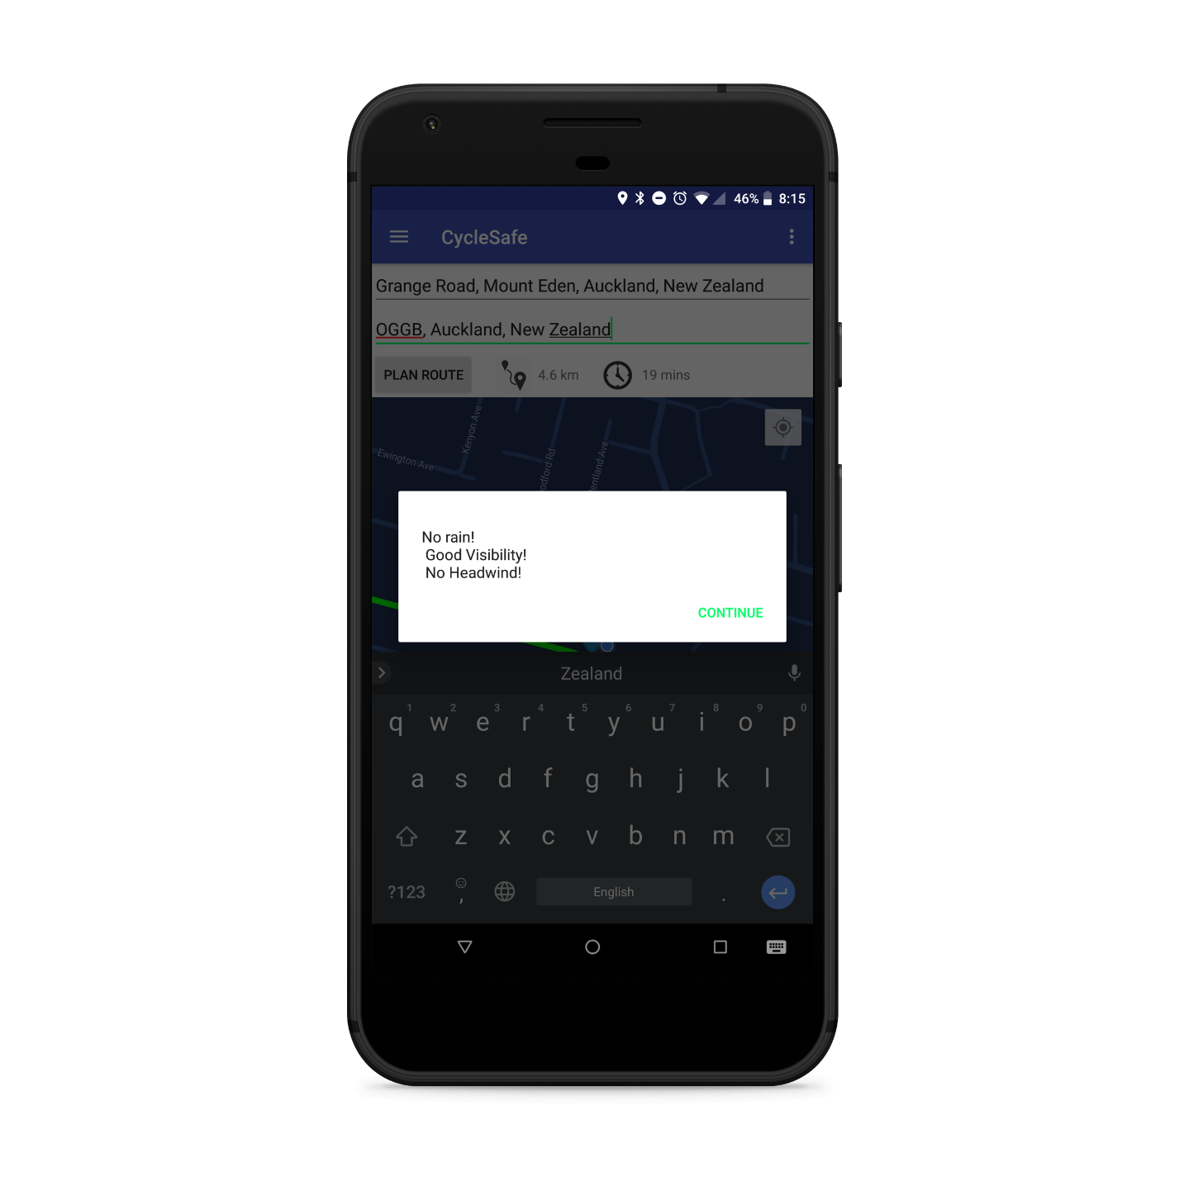
Our Solution
Mobile route planning application
Takes traffic & weather conditions into account
Notes:
Mention route is traffic and short path only weather is just warnings

Slide 16


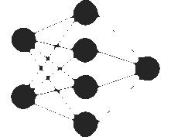
Features
Safe Commute Planning
Shortest Path with Traffic taken into account
Weather warnings – eg Rain, Low visibility and Headwind
Cycleways take priority
Safe Exercise Planning
Takes you on a safe loop
Machine Learning
App learns & predicts congestion
Provides warnings on unsafe travel periods for common routes

Slide 17
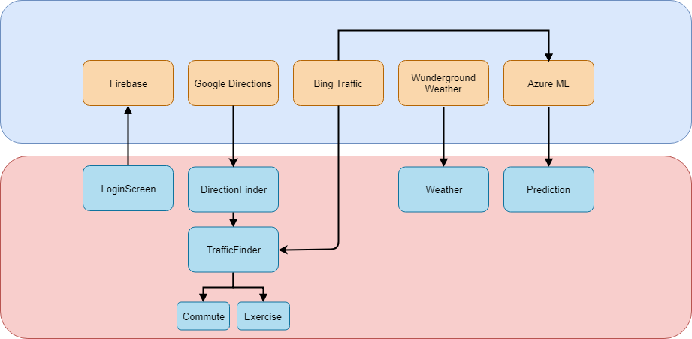
Our Solution (Architecture)
Cloud
Mobile App

Slide 18
Algorithm
Find Paths
Initially find multiple paths to destination using Google Directions API
Analyse
Check traffic for each segment of road
Compute
Give overall route a safety score
Plot
Plot safest route + Display weather warnings

Slide 19
Expected Outcome
Be routed away from unsafe traffic conditions
1
Weather warnings provided for unsafe/inconvenient weather
2
Exercise mode plans a route based on distance, safety and recreational areas
3
Application learns traffic conditions for routes and allows for future prediction
4

Slide 20
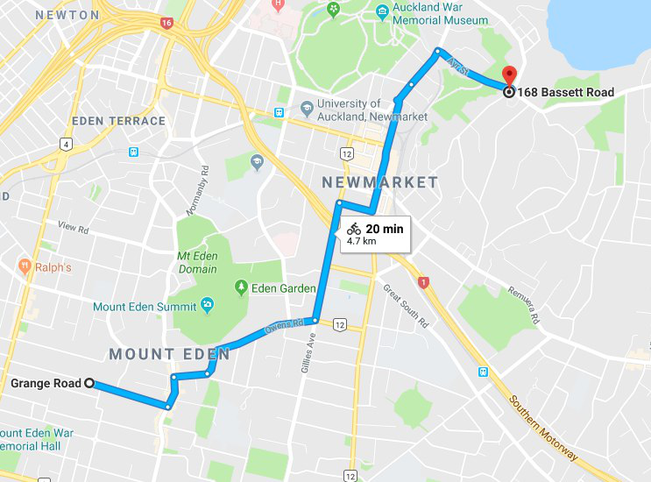
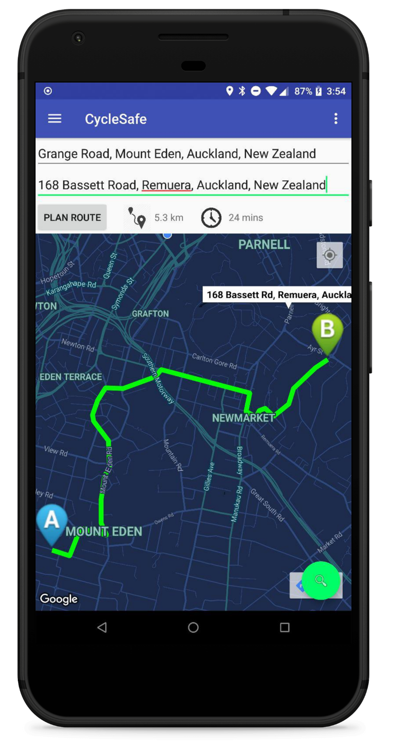
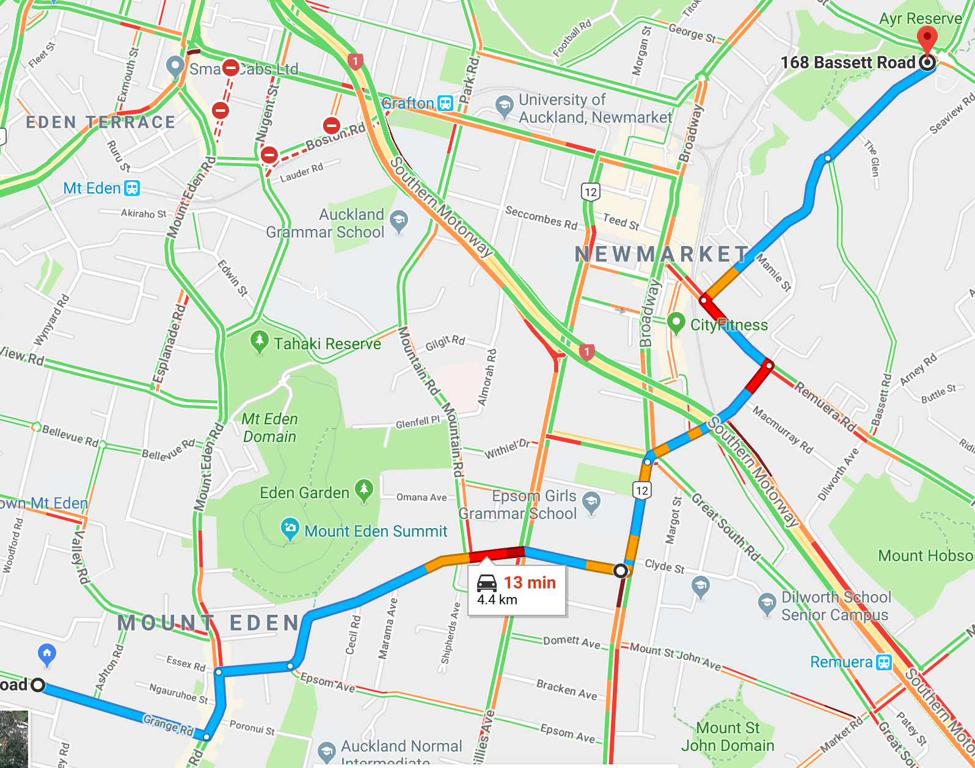

Slide 21
Future Work
Audio Queues
Integrate multiple traffic data sources
Different online services such as HERE maps, Google Traffic
Taxi FCD
Integrate with bike sharing services
User stat tracking
Exercise mode

Slide 22
Conclusion
Increasing number of cyclists
Current applications do not ensure cyclist safety
Our solution focuses on safety

